Slide 1
Chapter 4
Entity Relationship (ER) Modeling

Slide 2
Learning Objectives
In this chapter, you will learn:
The main characteristics of entity relationship components
How relationships between entities are defined, refined, and incorporated into the database design process
How ERD components affect database design and implementation
That real-world database design often requires the reconciliation of conflicting goals

Slide 3
Entity Relationship Model (ERM)
Basis of an entity relationship diagram (ERD)
ERD depicts the:
Conceptual database as viewed by end user
Database’s main components
Entities
Attributes
Relationships
Entity - Refers to the entity set and not to a single entity occurrence

Slide 4
Attributes
Characteristics of entities
Required attribute: Must have a value, cannot be left empty
Optional attribute: Does not require a value, can be left empty
Domain - Set of possible values for a given attribute
Identifiers: One or more attributes that uniquely identify each entity instance

Slide 5
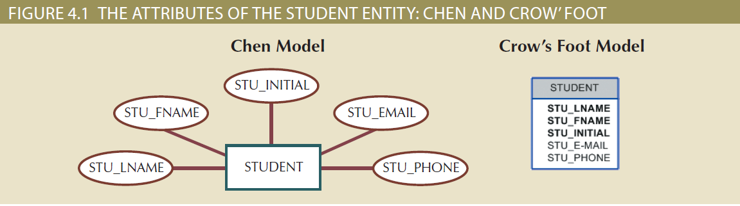
Figure 4.1 - The Attributes of the Student Entity: Chen and Crow’s Foot

Slide 6
Attributes
Composite identifier: Primary key composed of more than one attribute
Composite attribute: Attribute that can be subdivided to yield additional attributes
Simple attribute: Attribute that cannot be subdivided
Single-valued attribute: Attribute that has only a single value
Multivalued attributes: Attributes that have many values

Slide 7
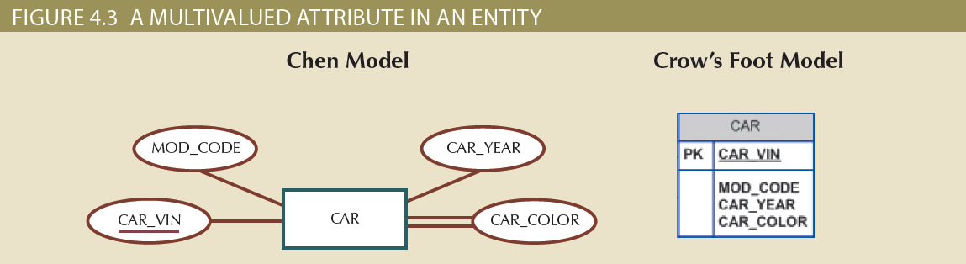
Figure 4.3 - A Multivalued Attribute in an Entity

Slide 8
Attributes
Multivalued attributes: Attributes that have many values and require creating:
Several new attributes, one for each component of the original multivalued attribute
A new entity composed of the original multivalued attribute’s components
Derived attribute: Attribute whose value is calculated from other attributes
Derived using an algorithm

Slide 9
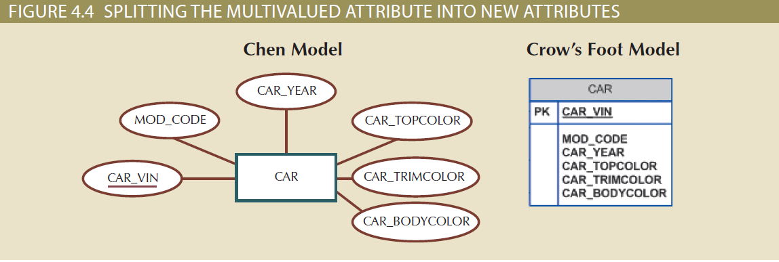
Figure 4.4 – Splitting the Multivalued Attributes into New Attributes

Slide 10
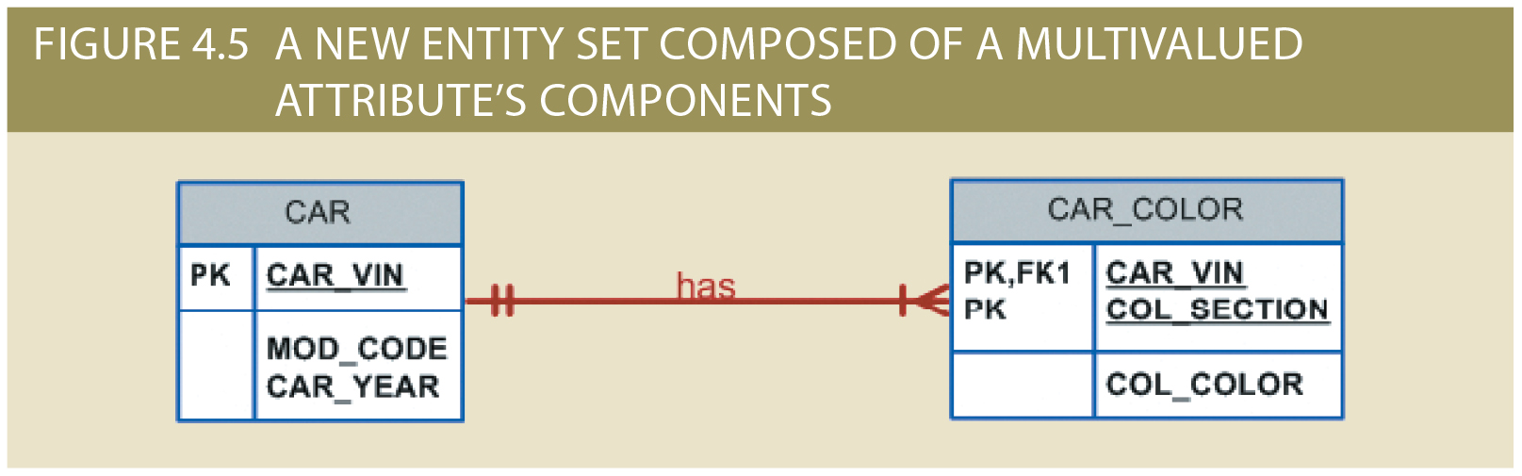

Slide 11
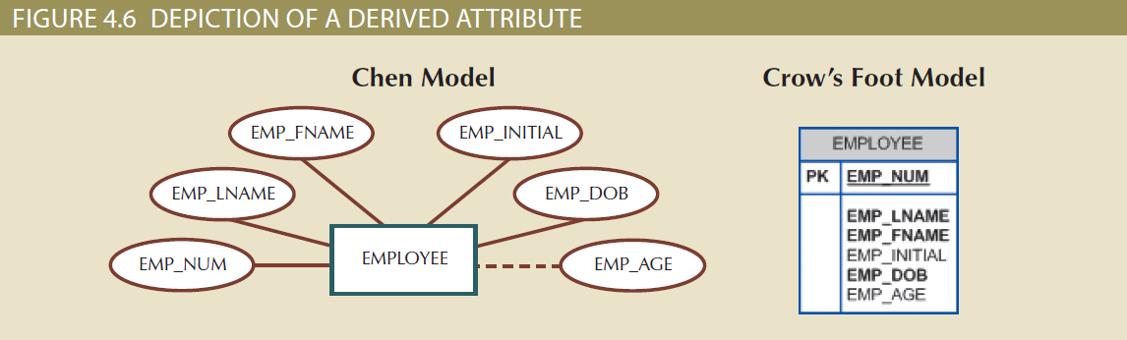
Figure 4.6 - Depiction of a Derived Attribute

Slide 12
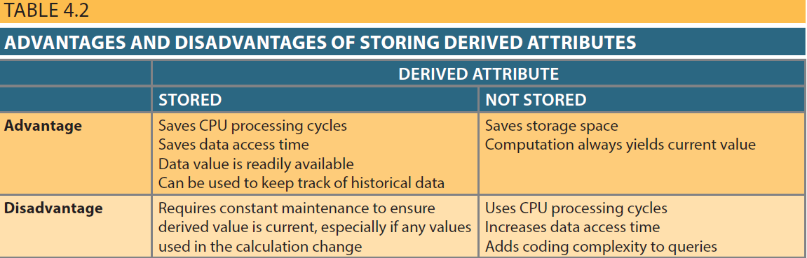
Table 4.2 - Advantages and Disadvantages of Storing Derived Attributes

Slide 13
Relationships
Association between entities that always operate in both directions
Participants: Entities that participate in a relationship
Connectivity: Describes the relationship classification
Cardinality: Expresses the minimum and maximum number of entity occurrences associated with one occurrence of related entity

Slide 14
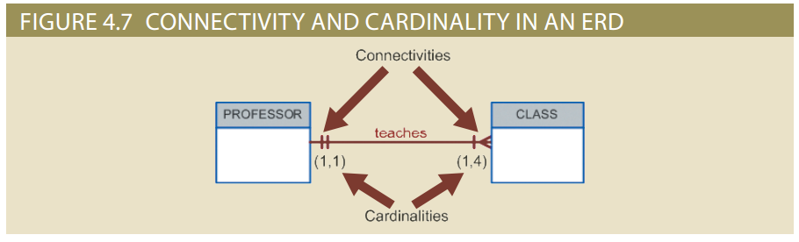
Figure 4.7 - Connectivity and Cardinality in an ERD

Slide 15
Existence Dependence
Existence dependence
Entity exists in the database only when it is associated with another related entity occurrence
Existence independence
Entity exists apart from all of its related entities
Referred to as a strong entity or regular entity

Slide 16
Relationship Strength
Weak (non-identifying) relationship
Primary key of the related entity does not contain a primary key component of the parent entity
Strong (identifying) relationships
Primary key of the related entity contains a primary key component of the parent entity

Slide 17
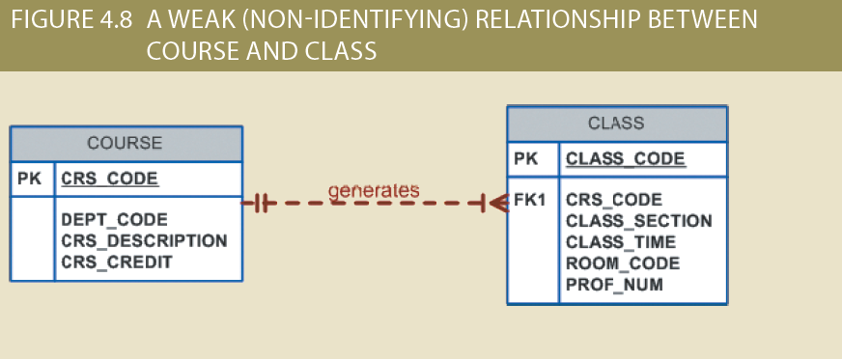
Figure 4.8 - A Weak (Non-Identifying) Relationship between COURSE and CLASS

Slide 18
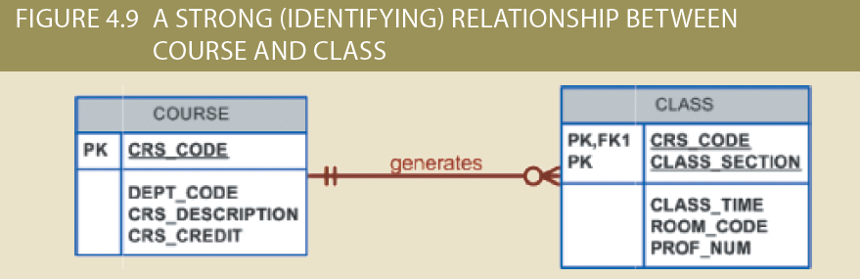
Figure 4.9 - A Strong (Identifying) Relationship between COURSE and CLASS

Slide 19
Weak Entity
Conditions
Existence-dependent
Has a primary key that is partially or totally derived from parent entity in the relationship
Database designer determines whether an entity is weak based on business rules

Slide 20
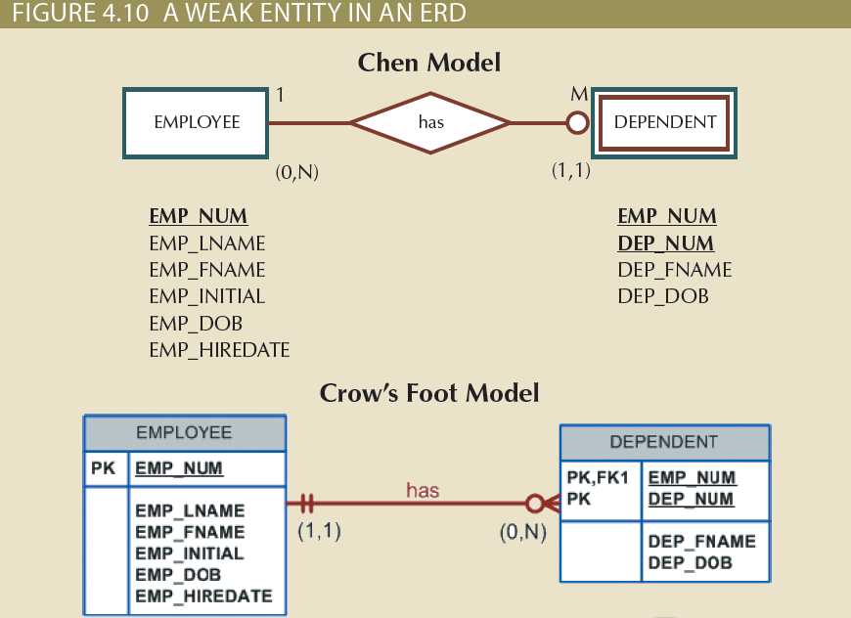
Figure 4.10 - A Weak Entity in an ERD

Slide 21
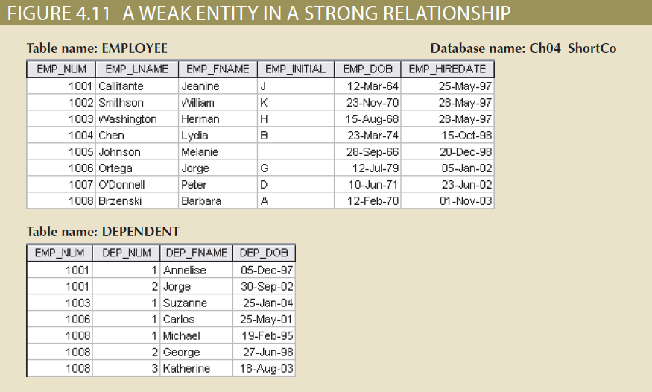
Figure 4.11 - A Weak Entity in a Strong Relationship

Slide 22
Relationship Participation
Optional participation
One entity occurrence does not require a corresponding entity occurrence in a particular relationship
Mandatory participation
One entity occurrence requires a corresponding entity occurrence in a particular relationship

Slide 23
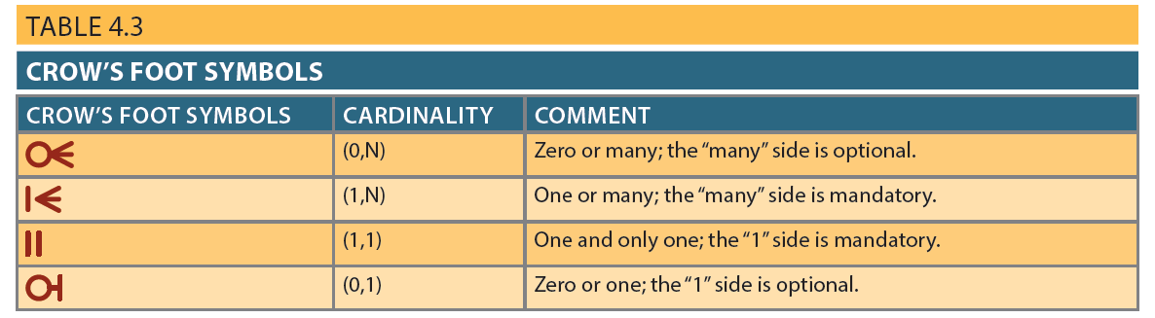
Table 4.3 - Crow’s Foot Symbols

Slide 24
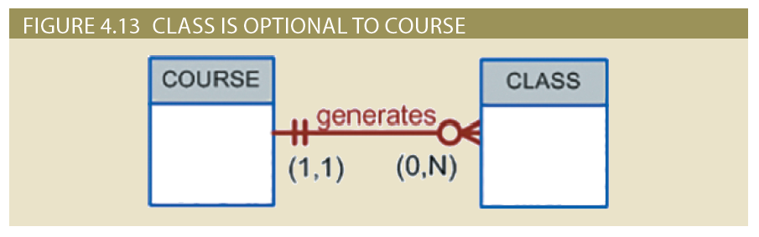
Figure 4.13 - CLASS is Optional to COURSE

Slide 25
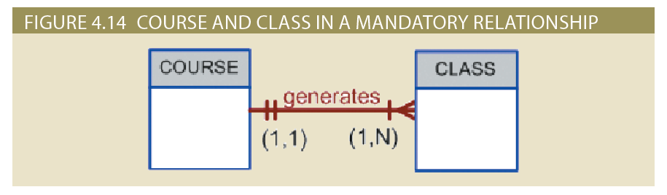
Figure 4.14 - COURSE and CLASS in a Mandatory Relationship

Slide 26
Relationship Degree
Indicates the number of entities or participants associated with a relationship
Unary relationship: Association is maintained within a single entity
Recursive relationship: Relationship exists between occurrences of the same entity set
Binary relationship: Two entities are associated
Ternary relationship: Three entities are associated

Slide 27
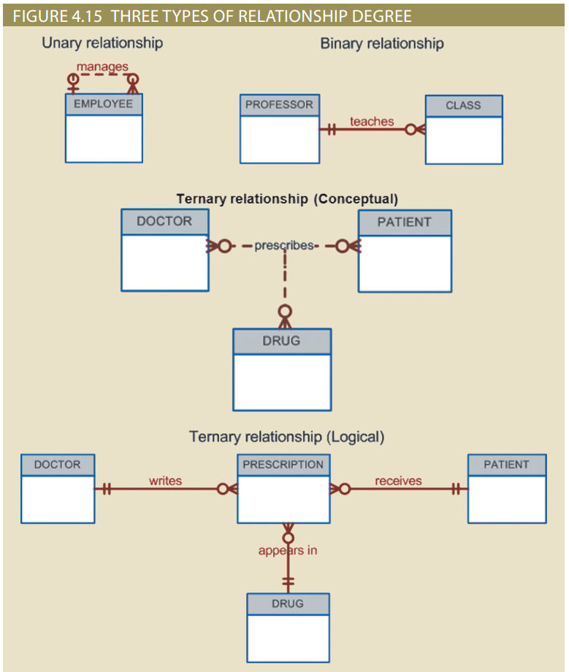
Figure 4.15 - Three Types of Relationship Degree

Slide 28
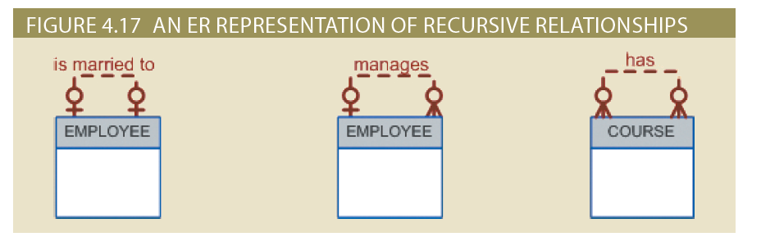
Figure 4.17 - An ER Representation of Recursive Relationships

Slide 29
Associative (Composite) Entities
Used to represent an M:N relationship between two or more entities
Is in a 1:M relationship with the parent entities
Composed of the primary key attributes of each parent entity
May also contain additional attributes that play no role in connective process

Slide 30
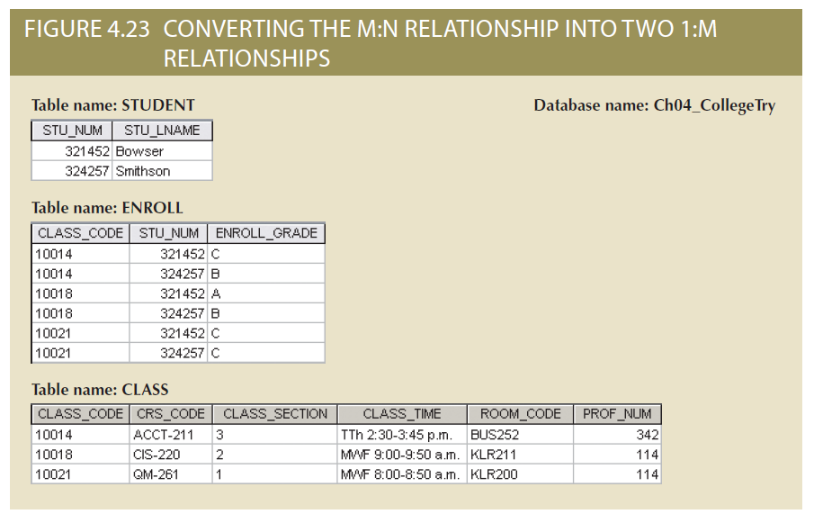
Figure 4.23 - Converting the M:N Relationship into Two 1:M Relationships

Slide 31
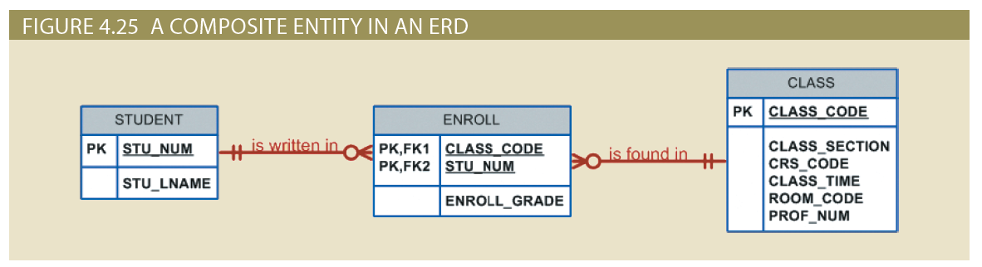
Figure 4.25 - A Composite Entity in an ERD

Slide 32
Developing an ER Diagram
Create a detailed narrative of the organization’s description of operations
Identify business rules based on the descriptions
Identify main entities and relationships from the business rules
Develop the initial ERD
Identify the attributes and primary keys that adequately describe entities
Revise and review ERD

Slide 33
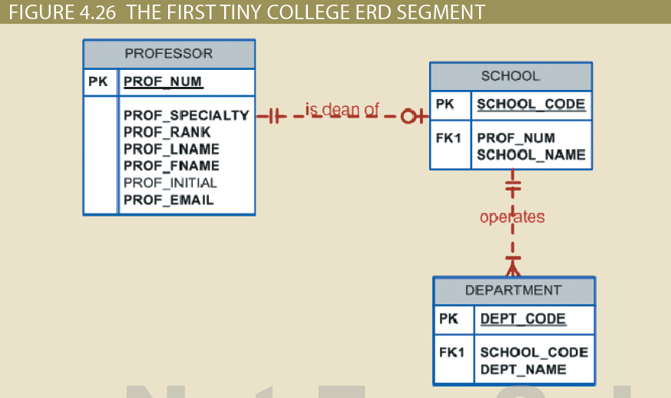
Figure 4.26 - The First Tiny College ERD Segment

Slide 34
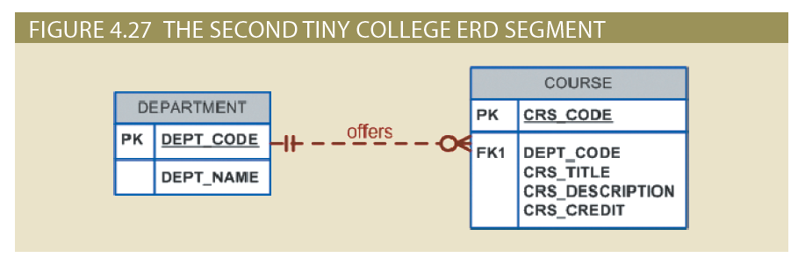
Figure 4.27 - The Second Tiny College ERD Segment

Slide 35
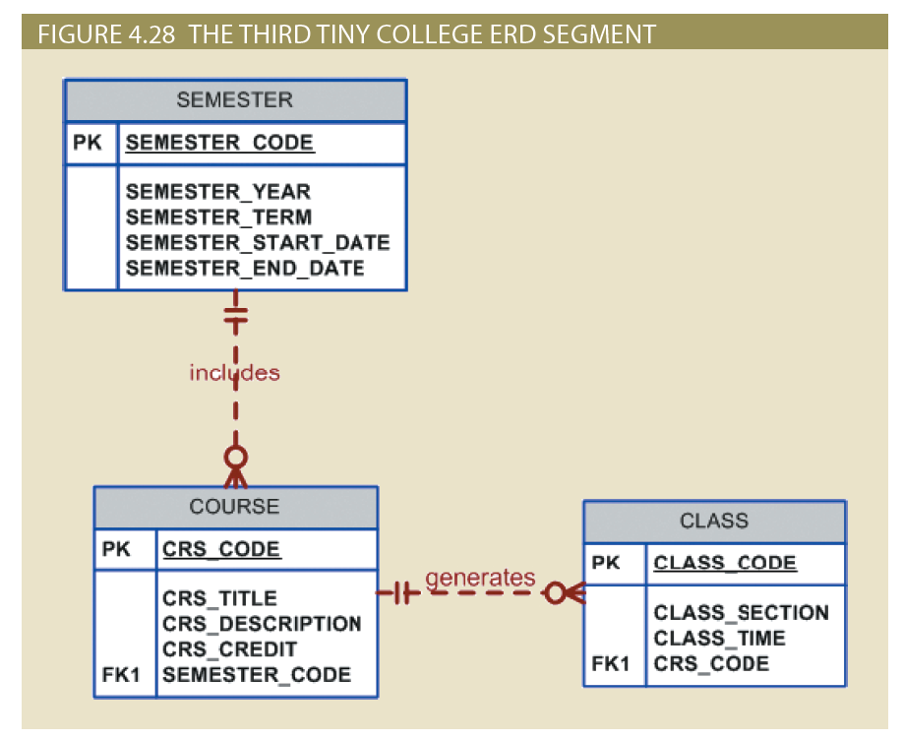
Figure 4.28 - The Third Tiny College ERD Segment

Slide 36
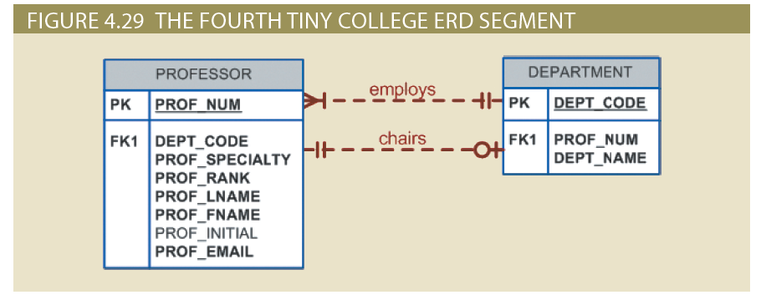
Figure 4.29 - The Fourth Tiny College ERD Segment

Slide 37
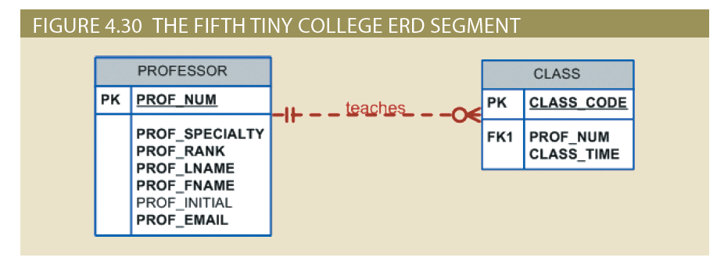
Figure 4.30 - The Fifth Tiny College ERD Segment

Slide 38
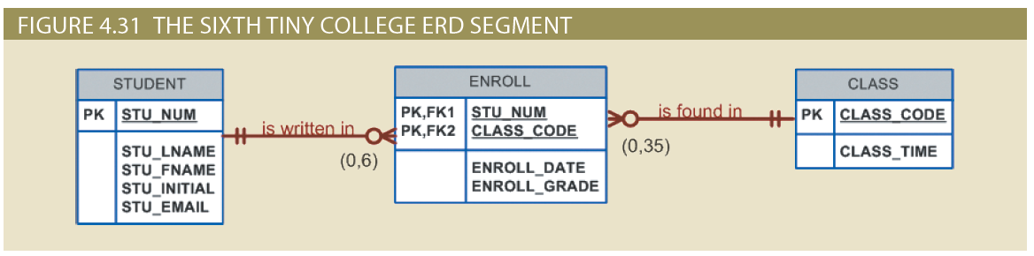
Figure 4.31 - The Sixth Tiny College ERD Segment

Slide 39
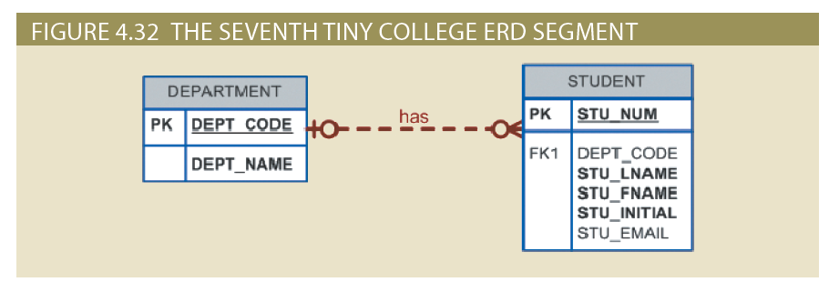
Figure 4.32 - The Seventh Tiny College ERD Segment

Slide 40
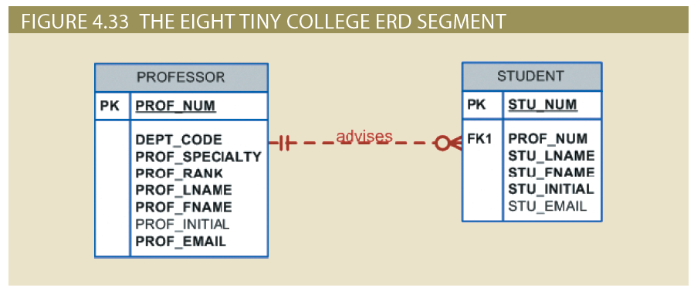
Figure 4.33 - The Eighth Tiny College ERD Segment

Slide 41
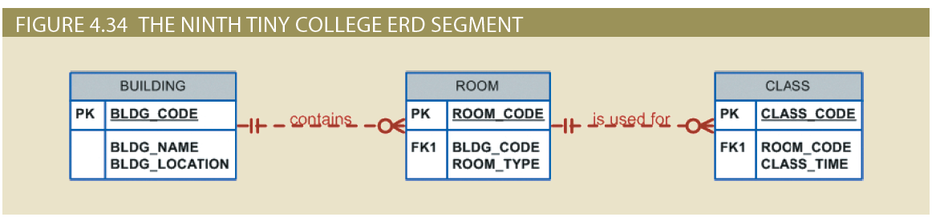
Figure 4.34 - The Ninth Tiny College ERD Segment

Slide 42
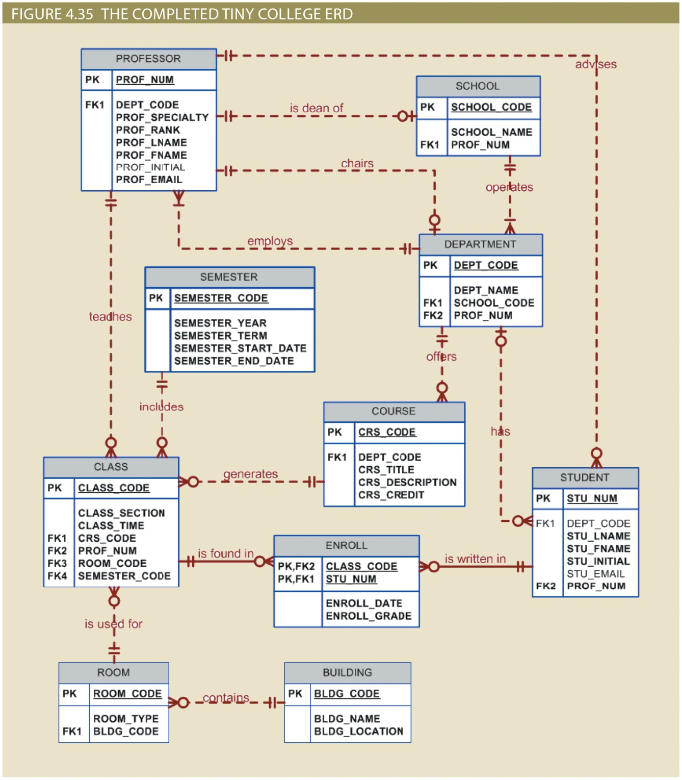

Slide 43
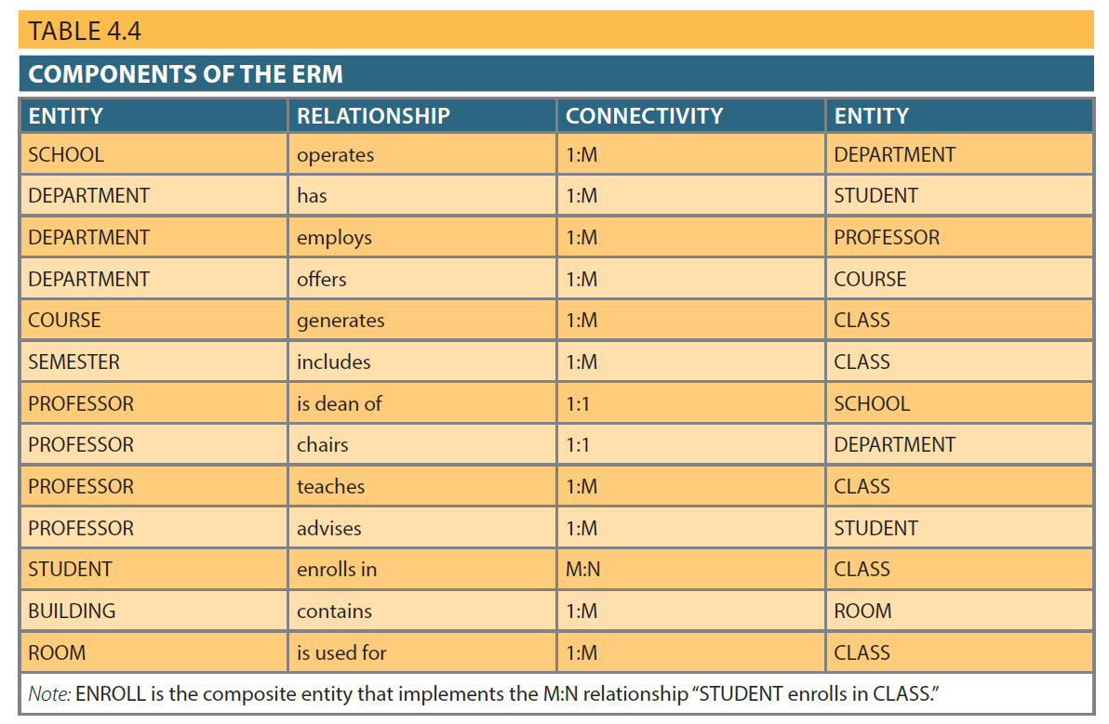
Table 4.4 - Components of the ERM

Slide 44
Database Design Challenges: Conflicting Goals
Database design must conform to design standards
Need for high processing speed may limit the number and complexity of logically desirable relationships
Need for maximum information generation may lead to loss of clean design structures and high transaction speed

Slide 45
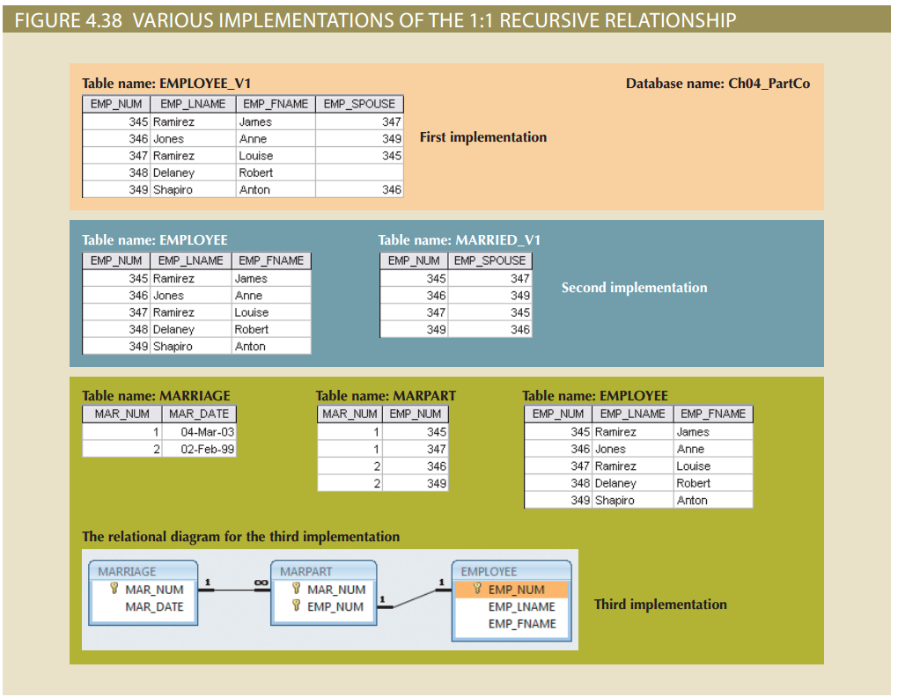
Figure 4.38 - Various Implementations of the 1:1 Recursive Relationship

